Slide 1
A Simple Introduction to Git: a distributed version-control system
CS 5010 Program Design Paradigms “Bootcamp”
Lesson 0.5
© Mitchell Wand, 2012-2014
This work is licensed under a Creative Commons Attribution-NonCommercial 4.0 International License.

Slide 2
Learning Objectives
At the end of this lesson you should be able to explain:
how git creates a mini-filesystem in your directory
what commit, push, pull, and sync do
the elements of the basic git workflow
how git allows you to work across multiple computers
how git allows you and a partner to work together

Slide 3
Git is a distributed version-control system
You keep your files in a repository on your local machine.
You synchronize your repository with a repository on a server.
If you move from one machine to another, you can pick up the changes by synchronizing with the server.
If your partner uploads some changes to your files, you can pick those up by synchronizing with the server.

Slide 4
Git is a distributed version-control system
Terminology: In git-speak, a “version” is called a “commit.”
Git keeps track of the history of your commits, so you can go back and look at earlier versions, or just give up on the current version and go back some earlier version.

Slide 5
A simple model of git
Most git documentation gets into details very quickly.
Here’s a very simple model of what’s going on in git.

Slide 6
Your files
my-project
docs
manual.docx
user_docs.docx
src
main.rkt
module1.rkt
module2.rkt
module3.rkt
Here are your files, sitting in a directory called my-project

Slide 7
Your files in your git repository
my-project
docs
manual.docx
user_docs.docx
src
main.rkt
module1.rkt
module2.rkt
module3.rkt
.git
When you have a git repository, you have an additional directory called .git, which points at a mini-filesystem.
This file system keeps all your data, plus the bells and whistles that git needs to do its job.
All this sits on your local machine.

Slide 8
The git client
my-project
docs
manual.docx
user_docs.docx
src
main.rkt
module1.rkt
module2.rkt
module3.rkt
.git
This mini-filesystem is highly optimized and very complicated. Don’t try to read it directly.
The job of the git client (either Github for Windows, Github for Mac, or a suite of command-line utilities) is to manage this for you.

Slide 9
Your workflow (part 1)
You edit your local files directly.
You can edit, add files, delete files, etc., using whatever tools you like.
This doesn’t change the mini-filesystem, so now your mini-fs is behind.

Slide 10
A Commit
my-project
docs
manual.docx
user_docs.docx
src
main.rkt
module1.rkt
module2.rkt
module3.rkt
.git
commit
When you do a “commit”, you record all your local changes into the mini-fs.
The mini-fs is “append-only”. Nothing is ever over-written there, so everything you ever commit can be recovered.

Slide 11
Synchronizing with the server (1)
a server, somewhere on the internet, eg. github.com
your local machine
my-project
docs
manual.docx
user_docs.docx
src
main.rkt
module1.rkt
module2.rkt
module3.rkt
.git
push
At the end of each work session, you need to save your changes on the server. This is called a “push”.
Now all your data is backed up.
You can retrieve it, on your machine or some other machine.
We can retrieve it (that’s how we collect homework)

Slide 12
Synchronizing with the server (2)
a server, somewhere on the internet, eg. github.com
your local machine
my-project
docs
manual.docx
user_docs.docx
src
main.rkt
module1.rkt
module2.rkt
module3.rkt
.git
pull
pull
To retrieve your data from the server, you do a “pull”. A “pull” takes the data from the server and puts it both in your local mini-fs and in your ordinary files.
If your local file has changed, git will merge the changes if possible. If it can’t figure out how to the merge, you will get an error message. We'll learn how to deal with these in the next lesson.

Slide 13
The whole picture
a server, somewhere on the internet, eg. github.ccs.neu.edu
your local machine
push
my-project
docs
manual.docx
user_docs.docx
src
main.rkt
module1.rkt
module2.rkt
module3.rkt
.git
pull
commit
pull

Slide 14
The whole picture using GHFW
your local machine
a server, somewhere on the internet, eg. github.ccs.neu.edu
my-project
docs
manual.docx
user_docs.docx
src
main.rkt
module1.rkt
module2.rkt
module3.rkt
.git
sync
commit
sync
In Gihub For Windows or Github For Mac, “push” and “pull” are combined into a single operation called “sync”. So in these clients, there are only two steps (“commit” and “sync”) to worry about, not three.

Slide 15
Your workflow (2)
sync
edit
Best practice: commit your work whenever you’ve gotten one part of your problem working, or before trying something that might fail.
If your new stuff is screwed up, you can always “revert” to your last good commit.
(Remember: always “revert”, never “roll back”)
commit
edit
commit
edit
commit
sync

Slide 16

Using Github for Windows/Mac

Slide 17
Your workflow with a partner
Your Partner (or you on another computer)
You
You
sync
sync
sync
edit
edit
edit
commit
commit
commit
edit
server
edit
server
edit
commit
commit
commit
edit
edit
edit
commit
commit
commit
sync
sync
sync
Your partner gets your work from the server
You get your partner’s work from the server

Slide 18
The new github desktop
In the next few slides, we’ll give you the updates for 2015.
We won’t be using github.com. Instead we will be using “Github for Enterprise” at https://github.ccs.neu.edu
The user interface for GHFW/GHFM has changed. It’s now called “Github Desktop”.
In the next few slides, we’ll show you how your daily workflow looks with new interface.

Slide 19
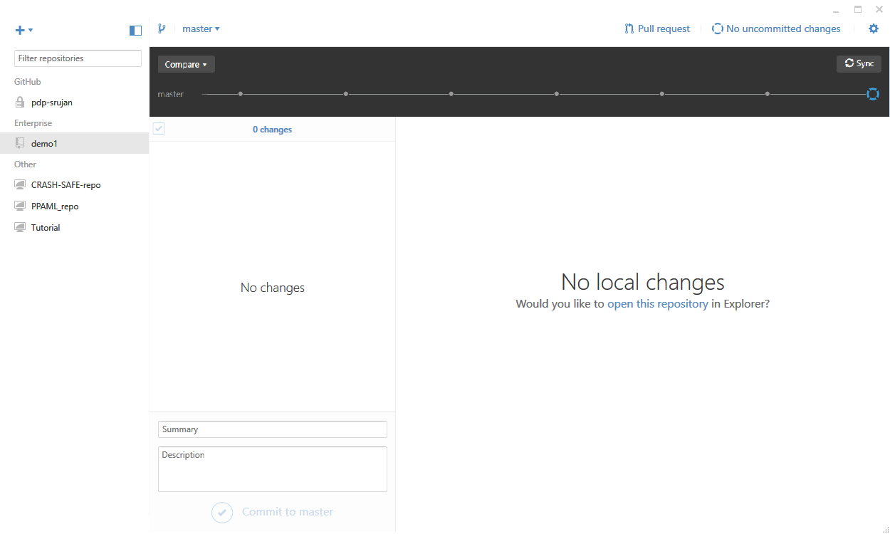
Starting your work session
Here’s what your Github Desktop should look like when you open it up. Observe that your repos will be in the section labeled “Enterprise”.

Slide 20
Where am I?
The open blue circle indicates that you are looking at the most recent local files

Slide 21
Always start by syncing
This will download any changes that you or your partner have made on other machines

Slide 22
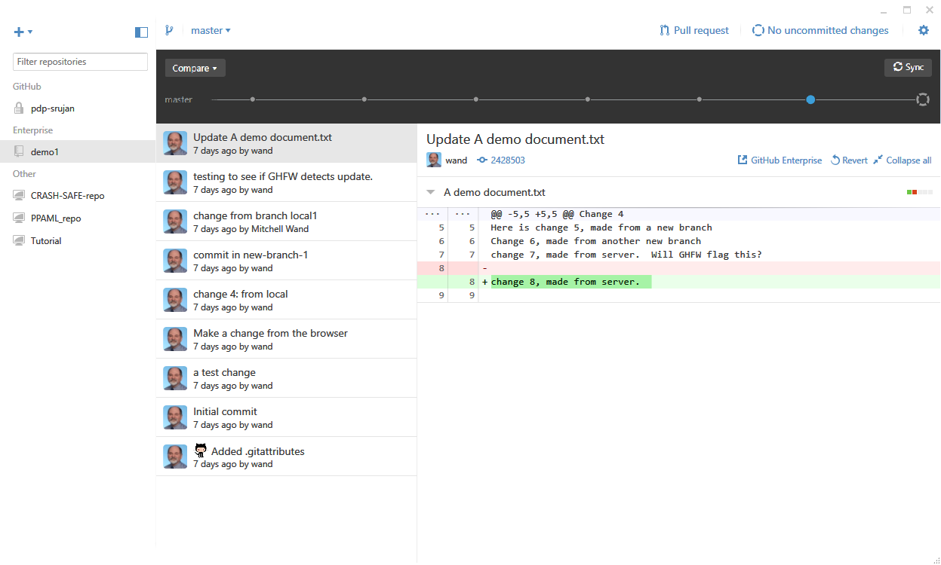
Click on a dot to see a commit
Clicking on the last dot will show you what was in your last commit
The dot turns blue

Slide 23
This shows your commit SHA
In this view, you can see the first 6 characters of the unique identifier (“the SHA”) for this commit
You’ll need it for your Worksession Report

Slide 24
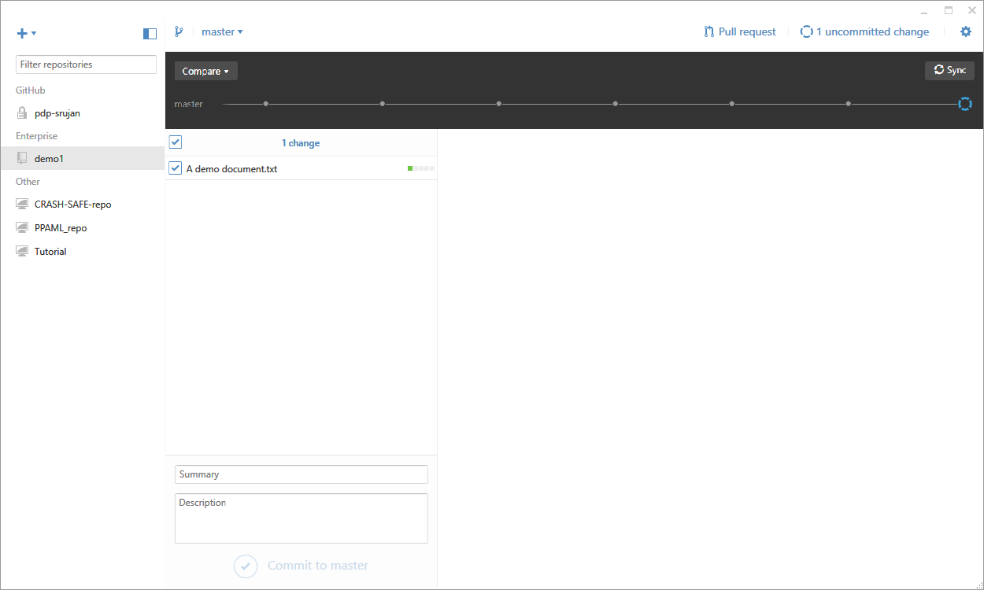
Now let’s work on our file
Now the screen shows an uncommitted change.

Slide 25
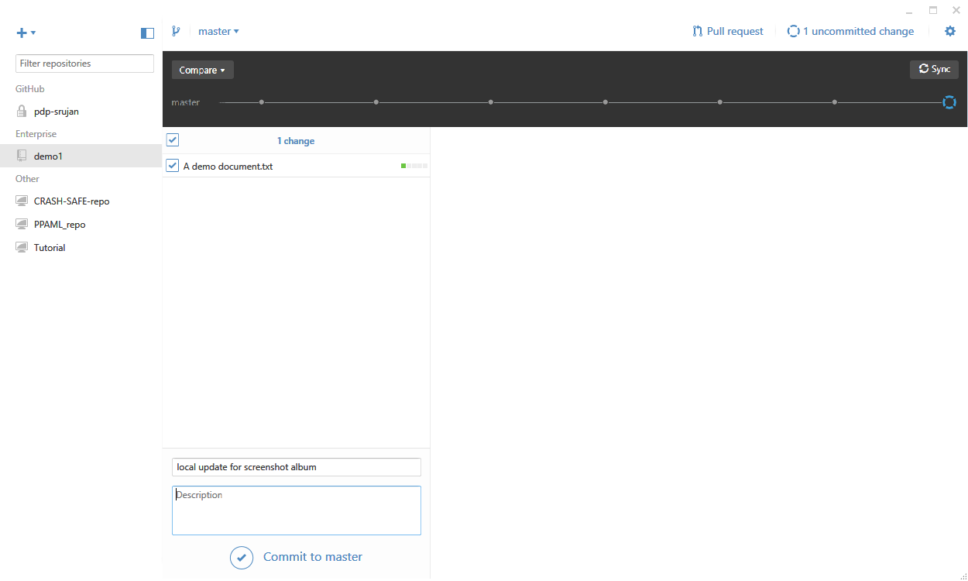
Next, we commit our work
We write a commit message. Then we’ll click on “Commit to Master”

Slide 26
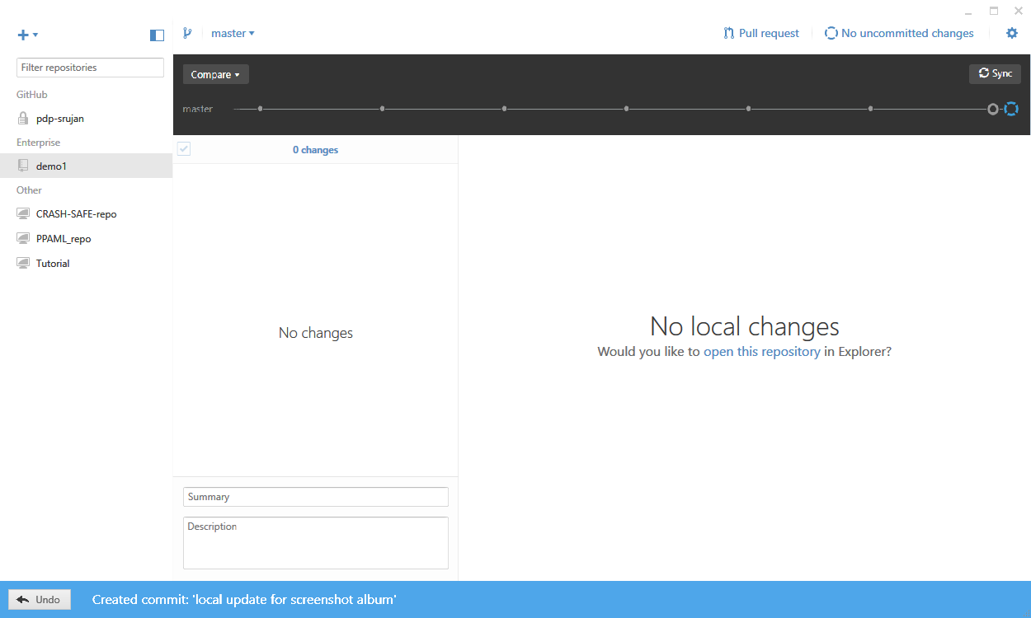
Here’s what you’ll see after a commit
Now it says “No uncommitted changes” again.
You can also undo the commit if you want.

Slide 27
Be sure to record the commit SHA
Click on the open circle to see what was in your commit, and to record the commit SHA. Here’s that screen again:

Slide 28
Be sure to sync!!!
Your work is not saved on the server until you sync.

Slide 29
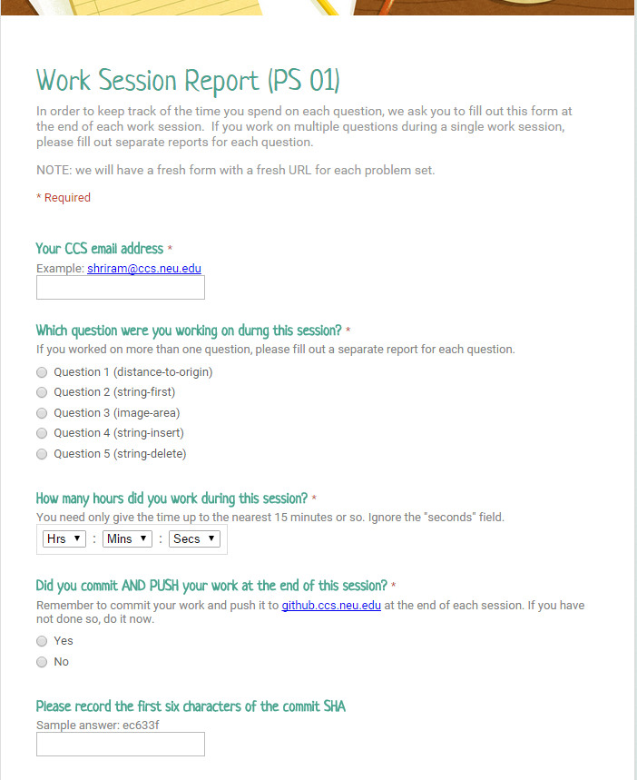
Submit a Work Session Report
At the end of your work session, submit a work session report via the web.
The URL for the work session report will appear in each problem set.
The report will ask for the SHA of your last commit. You can get this from the Github Desktop, as we’ve shown you.

Slide 30
Summary
In this lesson you have learned
that git creates a mini-filesystem in your directory
what commit, push, pull, and sync do
the elements of the basic git workflow
how git allows you to work across multiple computers
how git allows you and a partner to work together

